Slide 1

Nick baker, brian kiss, josh quinones, sam lambermont

Slide 2
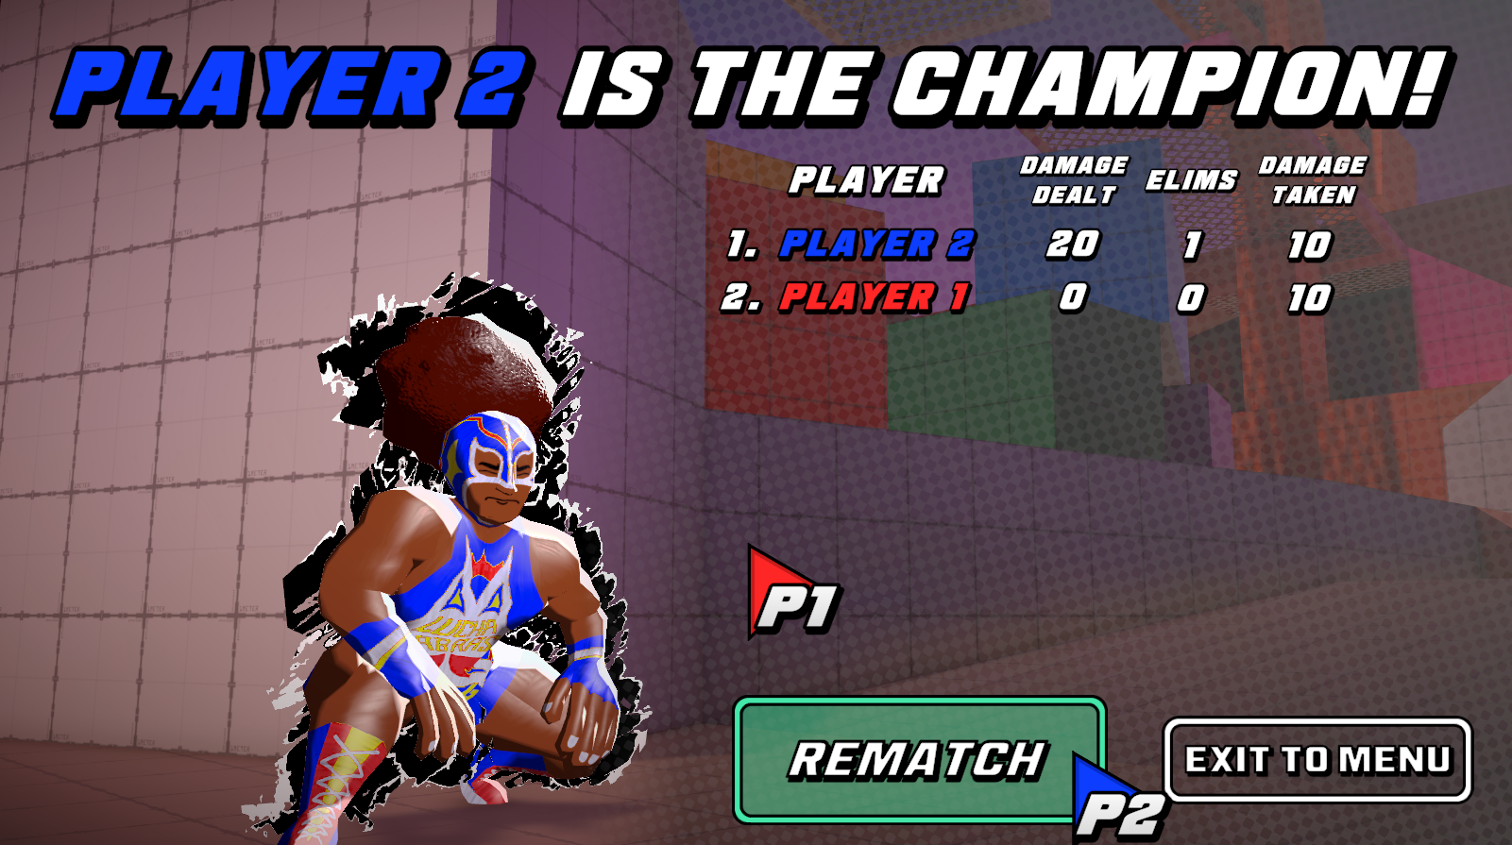
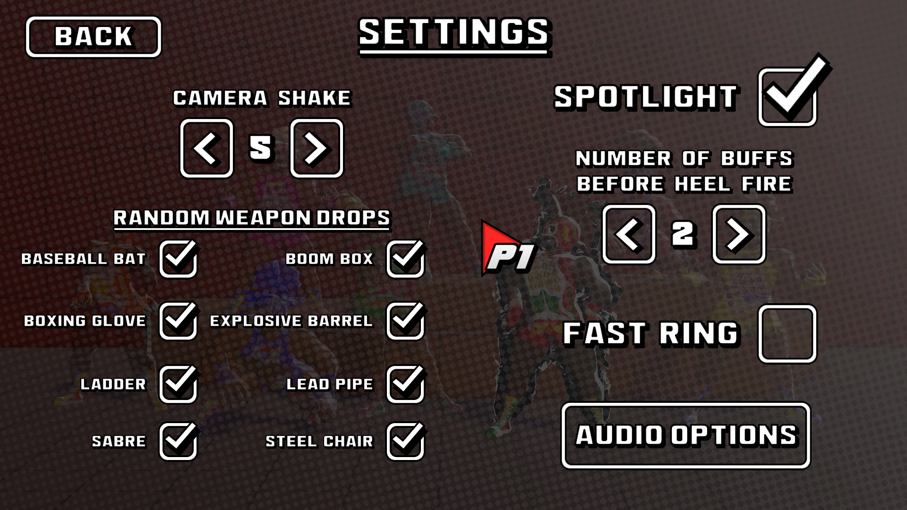
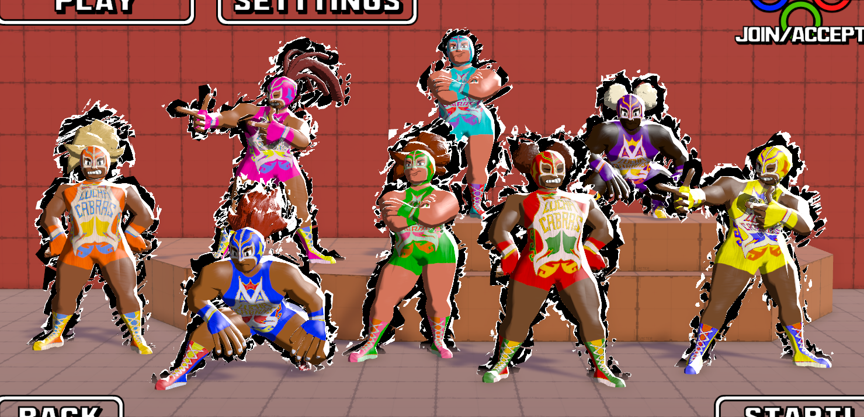
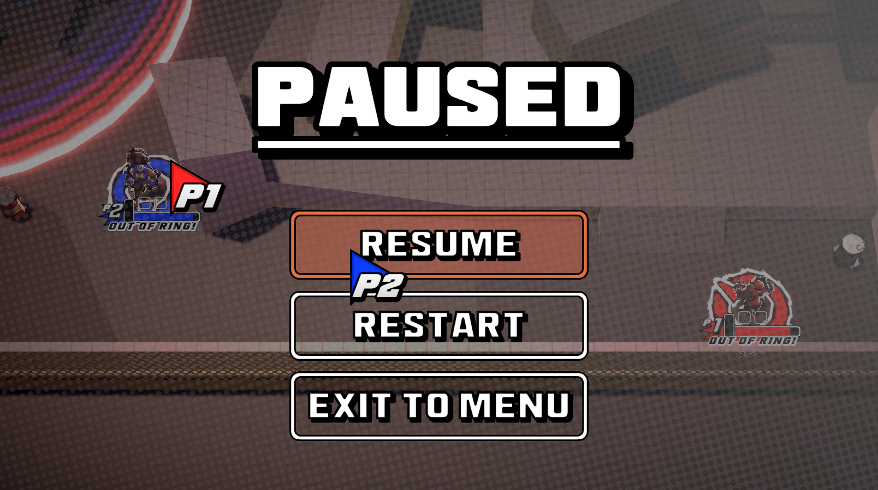
Menus

Slide 3
Audio
You’ve been hearing it during playtests.
Menu music.
Different sound effects on weapons.
Priority Announcement system.
Elims > Buffs > Damage.
More voice over lines.
No VO line repetition.
Audience cheers!
Fade in/out.

Slide 4
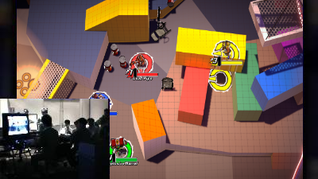



Wrapping things up
Arcade cabinet?!?
Steam?!?
Itch.IO?!?
EVO MOMENT #1337 ????

Slide 5
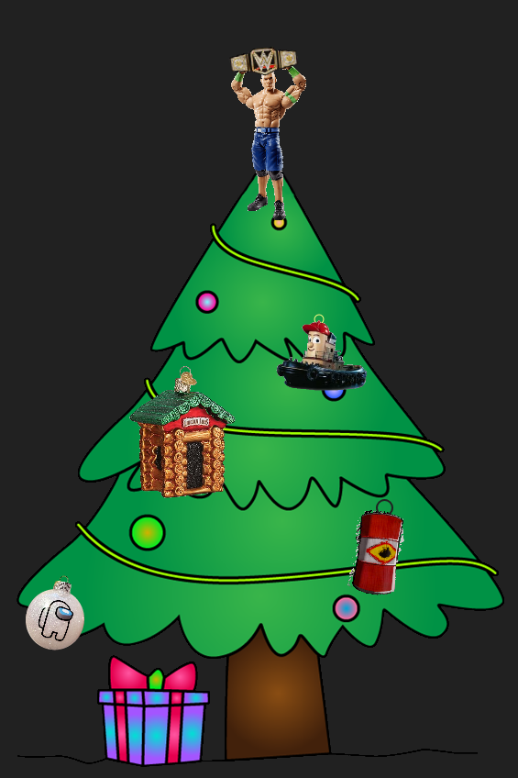
Link ’n logs
Github repo: https://github.com/nickybakes/580-game
Narrated Demo Video: https://youtu.be/ykkpe5vE14E

Slide 6


